Slide 1

Chapter 6- Buses
COMPUTER ORGANIZATION AND ARCHITECTURE
Course Code: 12CS35
Dept. of CSE
RVCE
Bangalore

Slide 2
Chapter Contents
Bus Arbitration,
Synchronous Bus,
Asynchronous Bus,
PCI bus,
SCSI bus,
USB- Version,
  Traffic modes,
  Architecture,
  Packet Structure.

Slide 3
Buses
Processor, main memory, and I/O devices are interconnected by means of a bus.
Bus provides a communication path for the transfer of data.
  Bus also includes lines to support interrupts and arbitration.
A bus protocol is the set of rules that govern the behavior of various devices connected to the bus, as to when to place information on the bus, when to assert control signals, etc.

Slide 4
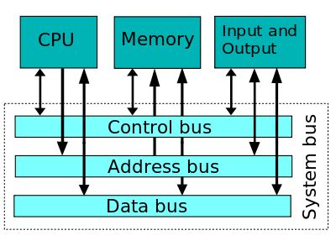
Buses In System

Slide 5
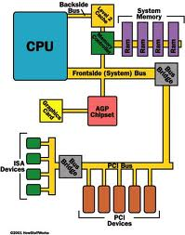
Layout view of Computer

Slide 6
Buses (contd..)
Bus lines may be grouped into three types:
  Data
  Address
  Control
Control signals specify:
  Whether it is a read or a write operation.
  Required size of the data, when several operand sizes (byte, word, long word) are possible.
  Timing information to indicate when the processor and I/O devices may place data or receive data from the bus.
Schemes for timing of data transfers over a bus can be classified into:
  Synchronous,
  Asynchronous.
Notes:
Recall that one device plays the role of a master. The device that initiates the data transfer on the bus by issuing read or write control signals is called as a master. The device that is being addressed by the master is called a slave or a target.

Slide 7
Synchronous bus
Bus clock
Bus cycle
All devices derive timing information from a common clock line.
The clock line has equally spaced pulses which define equal time intervals.
  In a simple synchronous bus, each of these pulses constitutes a bus cycle.
One data transfer can take place during one bus cycle.

Slide 8
Synchronous bus (contd..)
T
ime
Bus clock
Address and
command
Data
t
0
t
1
t
2
Master places the
device address and
command on the bus with l
ength of operand,
and indicates that
it is a Read operation.
Bus cycle
Addressed slave places
data on the data lines
Master “strobes” the data
on the data lines into its
input buffer, for a Read
operation.
In case of a Write operation, the master places the data on the bus along with the
address and commands at time t₀.
The slave strobes the data into its input buffer at time t₂.

Slide 9
Synchronous bus (contd..)
Once the master places the device address and command on the bus, it takes time for this information to propagate to the devices:
  This time depends on the physical and electrical characteristics of the bus.
Also, all the devices have to be given enough time to decode the address and control signals, so that the addressed slave can place data on the bus.
Width of the pulse t₁ - t₀ depends on:
  Maximum propagation delay between two devices connected to the bus.
  Time taken by all the devices to decode the address and control signals, so that the addressed slave can respond at time t₁.

Slide 10
Synchronous bus (contd..)
At the end of the clock cycle, at time t₂, the master strobes the data on the data lines into its input buffer if it’s a Read operation.
  “Strobe” means to capture the values of the data and store them into a buffer.
When data are to be loaded into a storage buffer register, the data should be available for a period longer than the setup time of the device.
Width of the pulse t₂ - t₁ should be longer than:
  Maximum propagation time of the bus plus
  Set up time of the input buffer register of the master.

Slide 11
Synchronous bus (contd..)
T
ime
Address &
command
appear on the
bus.
Bus clock
Data reaches
the master.
Seen by
master
t
AM
Address and
command
Address &
command reach
the slave.
Data
t
DM
Seen by slave
t
AS
Data appears
on the bus.
Address and
command
Data
t
DS
t
t
1
t
0
2
Signals do not appear on the bus as soon as they are placed on the bus, due to the
propagation delay in the interface circuits.
Signals reach the devices after a propagation delay which depends on the
characteristics of the bus.
Data must remain on the bus for some time after t₂ equal to the hold time of the buffer.

Slide 12
Synchronous bus (contd..)
Data transfer has to be completed within one clock cycle.
  Clock period t2 - t0 must be such that the longest propagation delay on the bus and the slowest device interface must be accommodated.
  Forces all the devices to operate at the speed of the slowest device.
Processor just assumes that the data are available at t2 in case of a Read operation, or are read by the device in case of a Write operation.
  What if the device is actually failed, and never really responded?

Slide 13
Synchronous bus (contd..)
Most buses have control signals to represent a response from the slave.
Control signals serve two purposes:
  Inform the master that the slave has recognized the address, and is ready to participate in a data transfer operation.
  Enable to adjust the duration of the data transfer operation based on the speed of the participating slaves.
High-frequency bus clock is used:
  Data transfer spans several clock cycles instead of just one clock cycle as in the earlier case.

Slide 14
Synchronous bus (contd..)
Address & command
requesting a Read
operation appear on
the bus.
T
ime
1
2
3
4
Clock
Address
Command
Master strobes data
into the input buffer.
Data
Sla
v
e-ready
Slave places the data on the bus,
and asserts Slave-ready signal.
Clock changes are seen by all the devices
at the same time.
Notes:
Slave-ready signal is an acknowledgement from the slave to the master to confirm that the valid data has been sent. Depending on when the slave-ready signal is asserted, the duration of the data transfer can change.

Slide 15
Asynchronous bus
Data transfers on the bus is controlled by a handshake between the master and the slave.
Common clock in the synchronous bus case is replaced by two timing control lines:
  Master-ready,
  Slave-ready.
Master-ready signal is asserted by the master to indicate to the slave that it is ready to participate in a data transfer.
Slave-ready signal is asserted by the slave in response to the master-ready from the master, and it indicates to the master that the slave is ready to participate in a data transfer.

Slide 16
Asynchronous bus (contd..)
Data transfer using the handshake protocol:
  Master places the address and command information on the bus.
  Asserts the Master-ready signal to indicate to the slaves that the address and command information has been placed on the bus.
  All devices on the bus decode the address.
  Address slave performs the required operation, and informs the processor it has done so by asserting the Slave-ready signal.
  Master removes all the signals from the bus, once Slave-ready is asserted.
  If the operation is a Read operation, Master also strobes the data into its input buffer.

Slide 17
Asynchronous bus (contd..)
T
ime
Address
and command
Master-ready
Slave-ready
Data
t
0
t
1
t
2
t
3
t
4
t
5
Bus cycle
t₀ - Master places the address and command information on the bus.
t₁ - Master asserts the Master-ready signal. Master-ready signal is asserted at t₁ instead of t₀
t₂ - Addressed slave places the data on the bus and asserts the Slave-ready signal.
t₃ - Slave-ready signal arrives at the master.
t₄ - Master removes the address and command information.
t₅ - Slave receives the transition of the Master-ready signal from 1 to 0. It removes the data and the Slave-ready signal from the bus.

Slide 18
Asynchronous vs. Synchronous bus
Advantages of asynchronous bus:
  Eliminates the need for synchronization between the sender and the receiver.
  Can accommodate varying delays automatically, using the Slave-ready signal.
Disadvantages of asynchronous bus:
  Data transfer rate with full handshake is limited by two-round trip delays.
  Data transfers using a synchronous bus involves only one round trip delay, and hence a synchronous bus can achieve faster rates.

Slide 19
PCI Bus
Peripheral Component Interconnect
Introduced in 1992
Low-cost bus
Processor independent
Plug-and-play capability
In today’s computers, most memory transfers involve a burst of data rather than just one word. The PCI is designed primarily to support this mode of operation.
The bus supports three independent address spaces: memory, I/O, and configuration.
we assumed that the master maintains the address information on the bus until data transfer is completed. But, the address is needed only long enough for the slave to be selected. Thus, the address is needed on the bus for one clock cycle only, freeing the address lines to be used for sending data in subsequent clock cycles. The result is a significant cost reduction.
A master is called an initiator in PCI terminology. The addressed device that responds to read and write commands is called a target.

Slide 20
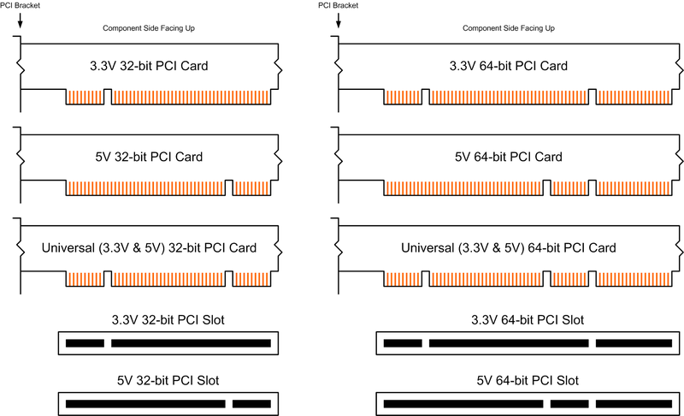
PCI Keying

Slide 21
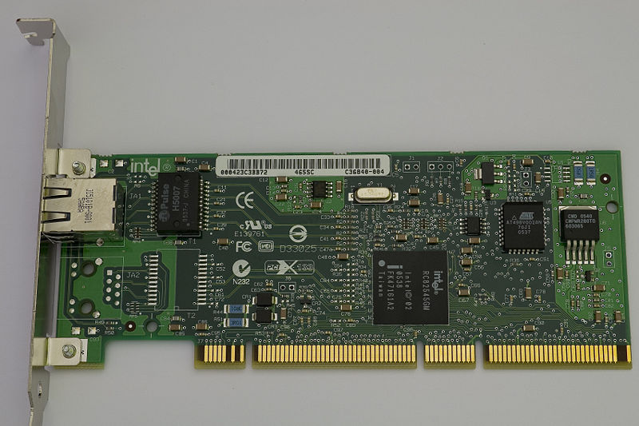
PCI Ethernet Card
Intel’s Gigabit Ethernet Card

Slide 22
Data transfer signals on the PCI bus.
Name
F
unction
CLK
A
33-MHz
or
66-MHz
clock.
FRAME#
Sent
b
y
the
initiator
to
indicate
the
duration
of
a
transaction.
AD
32
address/data
lines,
which
may
b
e
optionally
increased
to
64.
C/BE#
4
command/byte-enable
lines
(8
for
a
64-bit
bus).
IRD
Y#,
TRD
Y#
Initiator-ready
and
Target-ready
signals.
DEVSEL#
A
response
from
the
device
indicating
that
it
has
recognized
its
address
and
is
ready
for
a
data
transfer
transaction.
IDSEL#
Initialization
Device
Select.

Slide 23
1
2
3
4
5
6
7
CLK
Frame#
AD
Adress
#1
#2
#3
#4
C/BE#
Cmnd
Byte enable
IRD
Y#
TRD
Y#
DEVSEL#
A read operation on the PCI bus

Slide 24
Device Configuration
When an I/O device is connected to a computer, several actions are needed to configure both the device and the software that communicates with it.
PCI incorporates in each I/O device interface a small configuration ROM memory that stores information about that device.
The configuration ROMs of all devices are accessible in the configuration address space. The PCI initialization software reads these ROMs and determines whether the device is a printer, a keyboard, an Ethernet interface, or a disk controller. It can further learn bout various device options and characteristics.
Devices are assigned addresses during the initialization process.
This means that during the bus configuration operation, devices cannot be accessed based on their address, as they have not yet been assigned one.
Hence, the configuration address space uses a different mechanism. Each device has an input signal called Initialization Device Select, IDSEL#
Electrical characteristics:
  PCI bus has been defined for operation with either a 5 or 3.3 V power supply

Slide 25

SCSI Bus (1)
The acronym SCSI stands for Small Computer System Interface.
It refers to a standard bus defined by the American National Standards Institute (ANSI) under the designation X3.131 .
In the original specifications of the standard, devices such as disks are connected to a computer via a 50-wire cable, which can be up to 25 meters in length and can transfer data at rates up to 5 megabytes/s.
The SCSI bus standard has undergone many revisions, and its data transfer capability has increased very rapidly, almost doubling every two years.
SCSI-2 and SCSI-3 have been defined, and each has several options.
Because of various options SCSI connector may have 50, 68 or 80 pins.

Slide 26
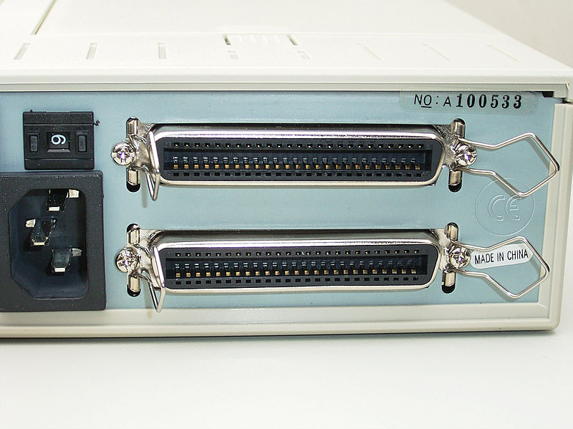
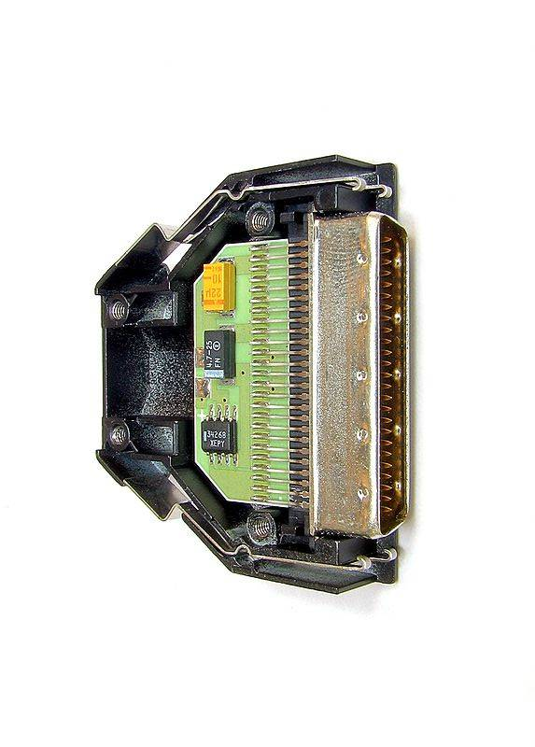
SCSI Connectors and Pins
SCSI Terminator Exposed
SCSI Connectors at the Back of ATX cabinet

Slide 27
SCSI Bus (2)
Devices connected to the SCSI bus are not part of the address space of the processor
The SCSI bus is connected to the processor bus through a SCSI controller. This controller uses DMA to transfer data packets from the main memory to the device, or vice versa.
A packet may contain a block of data, commands from the processor to the device, or status information about the device.
A controller connected to a SCSI bus is one of two types – an initiator or a target.
An initiator has the ability to select a particular target and to send commands specifying the operations to be performed. The disk controller operates as a target. It carries out the commands it receives from the initiator.
The initiator establishes a logical connection with the intended target.
Once this connection has been established, it can be suspended and restored as needed to transfer commands and bursts of data.
While a particular connection is suspended, other device can use the bus to transfer information.
This ability to overlap data transfer requests is one of the key features of the SCSI bus that leads to its high performance.

Slide 28
SCSI Bus (3)
Data transfers on the SCSI bus are always controlled by the target controller.
To send a command to a target, an initiator requests control of the bus and, after winning arbitration, selects the controller it wants to communicate with and hands control of the bus over to it.
Then the controller starts a data transfer operation to receive a command from the initiator.

Slide 29
SCSI Bus - Read Operation on Disk Drive(1)
Assume data are stored in disk sectors that are not contiguous.
The processor sends a command to the SCSI controller,
  The SCSI controller, acting as an initiator, contends for control of the bus.
  When the initiator wins the arbitration process, it selects the target controller and hands over control of the bus to it.
  The target starts an output operation (from initiator to target); in response to this, the initiator sends a command specifying the required read operation.
  The target, realizing that it first needs to perform a disk seek operation, sends a message to the initiator indicating that it will temporarily suspend the connection between them. Then it releases the bus.
  The target controller sends a command to the disk drive to move the read head to the first sector involved in the requested read operation. Then, it reads the data stored in that sector and stores them in a data buffer. When it is ready to begin transferring data to the initiator, the target requests control of the bus. After it wins arbitration, it reselects the initiator controller, thus restoring the suspended connection.

Slide 30
SCSI Bus - Read Operation on Disk Drive(2)
  The target transfers the contents of the data buffer to the initiator and then suspends the connection again
  The target controller sends a command to the disk drive to perform another seek operation. Then, it transfers the contents of the second disk sector to the initiator as before. At the end of this transfers, the logical connection between the two controllers is terminated.
  As the initiator controller receives the data, it stores them into the main memory using the DMA approach.
  The SCSI controller sends as interrupt to the processor to inform it that the requested operation has been completed

Slide 31
Operation of SCSI bus –Hardware Perspective
Category
Name
F
unction
Data
–
DB(0)
to
Data
lines:
Carry
one
b
yte
of
information
–
DB(7)
during
the
information
transfer
phase
and
iden
tify
device
during
arbitration,
selection
and
reselection
phases
–
DB(P)
P
arit
y
bit
for
the
data
bus
Phase
–
BSY
Busy:
Asserted
when
the
bus
is
not
free
–
SEL
Selection:
Asserted
during
selection
and
reselection
Information
–
C/D
Con
trol/Data:
Asserted
during
transfer
of
type
con
trol
information
(command,
status
or
message)
–
MSG
Message:
indicates
that
the
information being
transferred
is
a
message
Table 4. The SCSI bus signals.

Slide 32
Table 4. The SCSI bus signals.(cont.)
Category
Name
F
unction
Handshake
–
REQ
Request:
Asserted
b
y
a
target
to
request
a
data
transfer
cycle
–
A
CK
Ac
kno
wledge:
Asserted
b
y
the
initiator
when
it
has
completed
a
data
transfer
op
eration
Direction of
–
I/O
Input/Output:
Asserted
to
indicate
an
input
transfer
op
eration
e
(relativ
to
the
initiator)
–
Other
A
TN
A
tten
tion:
Asserted
b
y
an
initiator
when
it
wishes
to
send
a
message
to
a
target
–
RST
Reset:
Causes
all
device
con
trols
to
disconnect
from
the
bus
and
assume
their
start-up
state

Slide 33
SCSI Operation - Main Phases
Arbitration
  A controller requests the bus by asserting BSY and by asserting it’s associated data line
  When BSY becomes active, all controllers that are requesting bus examine data lines
Selection
  Controller that won arbitration selects target by asserting SEL and data line of target. After that initiator releases BSY line.
  Target responds by asserting BSY line
  Target controller will have control on the bus from then
Information Transfer
  Handshaking signals are used between initiator and target
  At the end target releases BSY line
Reselection

Slide 34
Targets examine ID
D
B
2
D
B
5
D
B
6
B
S
Y
S
E
L
Free
Arbitration
Selection
Figure 42. Arbitration and selection on the SCSI bus.
Device 6 wins arbitration and selects device 2.

Slide 35
Universal Serial Bus (USB)

Slide 36
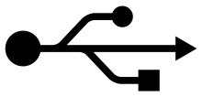
USB
Universal Serial Bus (USB) is an industry standard developed through a collaborative effort of several computer and communication companies, including Compaq, Hewlett-Packard, Intel, Lucent, Microsoft, Nortel Networks, and Philips.
Speed
    Low-speed(1.5 Mb/s)
    Full-speed(12 Mb/s)
    High-speed(480 Mb/s)
Port Limitation
Device Characteristics
Plug-and-play

Slide 37
Need for a USB
It provides a simple, low-cost and easy to use interconnection system that overcomes the difficulties due to the limited number of I/O ports available on a computer.
It accommodates a wide range of data transfer characteristics for I/O devices, including telephone and internet connections.
It enhances user convenience through a “plug-and-play” mode of operation.

Slide 38
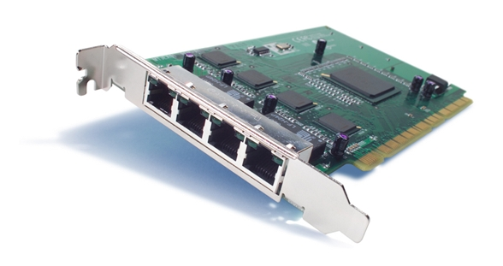
Port Limitation
In a typical computer, only a few parallel and series ports are provided as a general point of connection through which a variety of low-to medium-speed devices can be connected.
To add new ports, the user must open the computer box to gain access to the internal expansion bus and install a new interface card. The user must also need to know how to configure the device and the software.
A USB makes it possible to add many devices to a computer system at any time without opening the computer box.
Cisco PIX 64-Bit/66-MHz 4-Port Fast Ethernet Interface Card

Slide 39
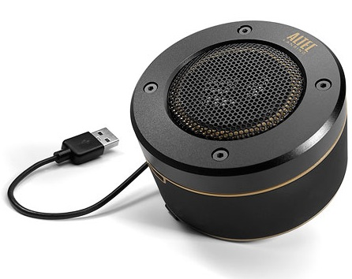

Plug-and-Play
The plug-and-play feature means that a new device (eg: speaker) can be connected at any time while the system is operating.
The system should detect the existence of this new device automatically, identify the appropriate device-driver software and any other facilities needed to service that device and establish the appropriate addresses and logical connections to enable them to communicate.
One of the primary objectives of the design of the USB has been to provide a plug-and-play capability.
Altec USB Speaker
Veho USB negative scanner

Slide 40
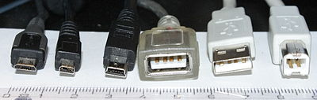

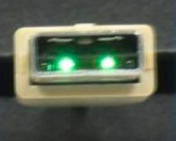
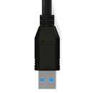
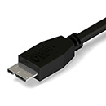

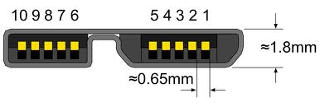
USB Connectors
USB 2.0
USB 3.0

Slide 41
USB Architecture
To accommodate a large number of devices that can be added or removed at any time, the USB has the tree structure.
Each node of the tree has a device called a hub, which acts as an intermediate control point between the host and the I/O devices. At the root of the tree, a root hub connects the entire tree to the host computer. The leaves of the tree are the I/O devices being served (eg: keyboard, Internet connection, speaker, or digital TV)
In normal operation, a hub copies a message that it receives from its upstream connection to all its downstream ports. As a result, a message sent by the host computer is broadcast to all I/O devices, but only the addressed device will respond to that message.
However, a message from an I/O device is sent only upstream towards the root of the tree and is not seen by other devices. Hence, the USB enables the host to communicate with the I/O devices, but it does not enable these devices to communicate with each other.

Slide 42
Universal Serial Bus tree structure
Host computer
Root
hub
Hub
Hub
Hub
de
I/O
I/O
I/O
I/O
vice
de
vice
de
vice
de
vice
de
I/O
I/O
vice
de
vice

Slide 43
Basic concepts and nomenclature
USB is a polled bus, meaning the host controller must initiate all transfers. This DOES NOT mean that the system software must poll the USB. The host controller takes care of polling the bus and can be programmed to issue interrupts to the OS whenever the bus needs attention.
USB System: A USB System consists of three discrete parts: the USB device(s), the USB interconnect, and the USB host.
  USB Devices: USB devices are classified as either a hub or a function. Hubs provide additional attachment points, whereas functions provide capabilities to the system. Functions are the I/O devices.
  USB Interconnect: The USB interconnect provides a connection from the USB device(s) to the USB host. Physically, the USB interconnect is a tiered star topology. A maximum of seven tiers are allowed, and the root hub occupies the first tier.
  USB Host: A USB system contains only one USB host. The host interfaces with the USB interconnect via a host controller. The host includes an embedded hub called the root hub which provides one or more attachment points, or ports.

Slide 44
Universal Serial Bus tree structure
USB has tree structure to accommodate large number of devices.
Each node of the tree has a device called a hub.
  Hub is an intermediate control point between the host and the I/O devices.
  At the root of the tree is the root hub connects the entire tree to the host computer.
  The leaves of the tree are the I/O devices being served
  for example, keyboard, Internet connection, speaker, or digital TV
USB normal operation
  A hub copies a message that it receives from its upstream connection to all its downstream ports.
  A message sent by the host computer is broadcast to all I/O devices, but only the addressed device will respond to that message.
  The message from an I/O device is sent only upstream towards the root of the tree and is not seen by other devices.
Hence, the USB enables the host to communicate with the I/O devices, but it does not enable these devices to communicate with each other.

Slide 45
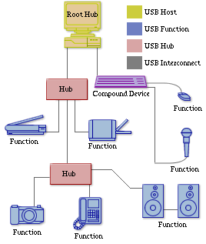
USB System Illustration

Slide 46
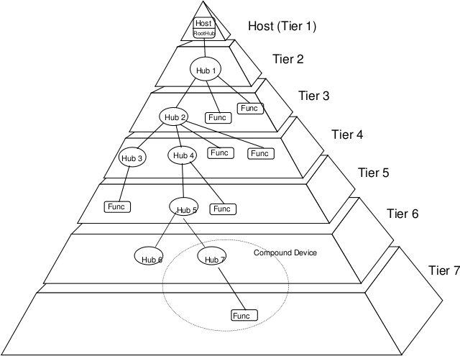
USB Topology
Some devices may implement several functions and an embedded hub in one physical package. These are called compound devices. Since compound devices contain an embedded hub, a compound device cannot be attached in tier 7.

Slide 47
Addressing (1)
When a USB is connected to a host computer,
  Root hub is attached to the processor bus, where it appears as a single device.
  The host software communicates with individual devices attached to the USB by sending packets of information, which the root hub forwards to the appropriate device in the USB tree.
Each device on the USB, whether it is a hub or an I/O device, is assigned a 7-bit address.
This address is local to the USB tree and is not related in any way to the addresses used on the processor bus.
A hub may have any number of devices or other hubs connected to it, and addresses are assigned arbitrarily. When a device is first connected to a hub, or when it is powered on, it has the address 0.

Slide 48
Addressing (2)
The hardware of the hub to which this device is connected is capable of detecting that the device has been connected, and it records this fact as part of its own status information.
Periodically, the host polls each hub to collect status information and learn about new devices that may have been added or disconnected.
When the host is informed that a new device has been connected, it uses a sequence of commands to send a reset signal on the corresponding hub port,
read information from the device about its capabilities, send configuration information to the device, and assign the device a unique USB address.
Once this sequence is completed the device begins normal operation and responds only to the new address.

Slide 49
USB Protocols
All information transferred over the USB is organized in packets, where a packet consists of one or more bytes of information. There are many types of packets that perform a variety of control functions.
The information transferred on the USB can be divided into two broad categories: control and data.
  Control packets perform such tasks as addressing a device to initiate data transfer, acknowledging that data have been received correctly, or indicating an error.
  Data packets carry information that is delivered to a device.
A packet consists of one or more fields containing different kinds of information. The first field of any packet is called the packet identifier, PID, which identifies the type of that packet.
They are transmitted twice. The first time they are sent with their true values, and the second time with each bit complemented
The four PID bits identify one of 16 different packet types. Some control packets, such as ACK (Acknowledge), consist only of the PID byte.

Slide 50
PID
PID
PID
PID
PID
0
1
2
3
PID
0
PID
PID
PID
0
1
2
3
(a) Packet identifier field
Bits
8
7
4
5
Control packets used for controlling data transfer operations are called token packets.
PID
ADDR
ENDP
CRC16
(b) Token packet, IN or OUT
Bits
8
0 to 8192
16
PID
D
A
T
A
CRC16
(c) Data packet
Figure 45. USB packet format.

Slide 51
Output Transfer
The host computer sends a token packet of type OUT to the hub, followed by a data packet containing the output data.
The PID field of the data packet identifies it as data packet number 0.
The hub verifies that the transmission has been error free by checking the error control bits, then sends an acknowledgement packet(ACK) back to the host.
The hub forwards the token and data packets downstream where all I/O devices receive it but only the device that recognizes its address in the token packet accepts the data in the packet that follows. After verifying that transmission has been error free, it sends an ACK packet to the hub.
Input operations follow a similar procedure. The host sends a token packet of type IN containing the device address. In effect, this packet is a poll asking the device to send an input data it may have. The device responds by sending a data packet followed by an ACK. If it has no data ready, it responds by sending a negative acknowledgement (NAK) instead.

Slide 52
Host
Hub
I/O De
vice
T
ok
en
Data0
A
CK
Time
T
ok
en
Data0
A
CK
T
ok
en
Figure: An output
transfer
Data1
A
CK
T
ok
en
Data1
A
CK

Slide 53
PID Type | PID Name | PID [3:0] | Description
Token | OUT | 0001b | The packet describes a host-to-function transaction.
 | IN | 1001b | The packet describes a function-to-host transaction.
 | SOF | 0101b | The packet marks the start of frame and specifies the frame number.
 | SETUP | 1101b | Packet describes a SETUP transaction from the host to the function via a control pipe.
Data | DATA0 | 0011b | This packet is an even data packet.
 | DATA1 | 1011b | This packet is an odd data packet
 | DATA2 | 0111b | This packet is only used in high-speed, high-bandwidth isochronous transfers.
 | MDATA | 1111b | This packet is only used in split transactions, or high-speed, high-bandwidth isochronous transfers.
Handshake | ACK | 0010b | This packet acknowledges the successful receipt of a data packet.
 | NAK | 1010b | This packet indicates that data is not ready to be transmitted yet.
 | STALL | 1110b | This packet indicates that the endpoint has halted, or a control pipe does not support a certain request.
 | NYET | 0110b | The receiver has not yet responded, or the host should begin sending PING packets.
Special | PRE | 1100b | This packet is a host-issued preamble for a split-transaction.
 | ERR | 1100b | This packet is a handshake response that a split transaction error occurred. Note that this PID is identical to the PID for a PRE packet.
 | SPLIT | 1000b | This packet supports split transactions between the host and a high-speed hub.
 | PING | 0100b | This packet is used for flow-control in high-speed control and bulk transfers.
 | Reserved | 0000b | This is a reserved PID and must not be used.
PID Types (in USB 2.0)

Slide 54
4 Basic Transfer Types:
Control Transfers provide lossless transmissions and are used to configure a device. Thus, all USB devices must support control transfers at least via the default control pipe.
Bulk Data Transfers provide lossless, sequential transmissions and are typically used to transfer large amounts of data.
Interrupt Data Transfers provide reliable, limited-latency transmissions typically needed by human input devices such as a mouse or a joystick.
Isochronous Data Transfers, also called Streaming Real-time Transfers, negotiate a required bandwidth and latency when initializing the transfer. This transfer type is predominantly used for such applications as streaming audio. Since data-delivery rate is considered more important than data integrity for this type of transfer, it does not provide any type of error checking or correction mechanism.

Slide 55
Isochronous Traffic on USB
One of the key objectives of the USB is to support the transfer of isochronous data.
Devices that generates or receives isochronous data require a time reference to control the sampling process.
To provide this reference. Transmission over the USB is divided into frames of equal length.
A frame is 1ms long for low-and full-speed data.
The root hub generates a Start of Frame control packet (SOF) precisely once every 1 ms to mark the beginning of a new frame.
The arrival of an SOF packet at any device constitutes a regular clock signal that the device can use for its own purposes.
To assist devices that may need longer periods of time, the SOF packet carries an 11-bit frame number.
Following each SOF packet, the host carries out input and output transfers for isochronous devices.
This means that each device will have an opportunity for an input or output transfer once every 1 ms.

Slide 56
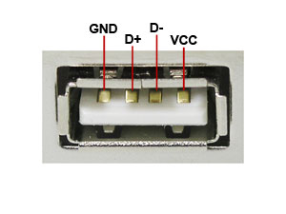
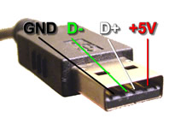
USB 2.0 Pinout
PIN | NAME | CABLE COLOR | DESCRIPTION
1 | Vcc | Red | +5 Vdc
2 | D- | White | Data -
3 | D+ | Green | Data +
4 | GND | Black | Ground
USB is a serial bus. It uses 4 shielded wires: two for power (+5V & GND) and two for differential data signals (labeled as D+ and D- in pinout).

Slide 57
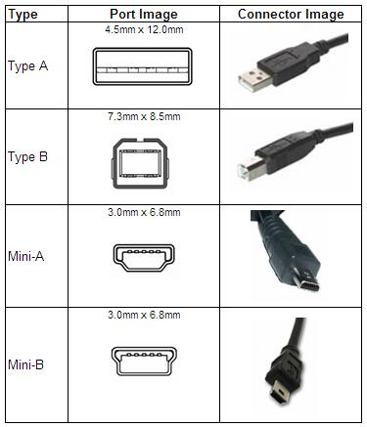
There are 4 types of USB 2.0 ports and connectors:

Slide 58

USB 3.0
USB 3.0, also known as the SuperSpeed bus, was designed to address the limitation of slow transfer rate.
USB 3.0 introduces a fourth transfer mode of 5Gbps (gigabits per second). This new transfer mode upgrades the USB technology to support a maximum throughput of about 600MB/s while still maintaining backwards compatibility with the older signaling rates.
This allows a USB 3.0 mass storage device to be connected onto a legacy USB 2.0/1.1 port, and likewise. There are two types of connector and plug combinations in USB 3.0 specification, SuperSpeed standard A and SuperSpeed standard B.
USB Signaling Rate Chart
Low Speed | USB 1.0 | 1.5 Mbps
Full Speed | USB 1.1 | 12 Mbps
Hi-Speed | USB 2.0 | 480 Mbps
SuperSpeed | USB 3.0 | 5 Gbps
SuperSpeed standard A plugs will fit legacy A receptacles but SuperSpeed standard B plugs will not fit into legacy standard B receptacles.

Slide 59
USB- Electrical Characteristics
The cables used for USB connections consist of four wires.
Two are used to carry power, +5V and Ground.
  Thus, a hub or an I/O device may be powered directly from the bus, or it may have its own external power connection.
The other two wires are used to carry data.
Different signaling schemes are used for different speeds of transmission.
  At low speed, 1s and 0s are transmitted by sending a high voltage state (5V) on one or the other o the two signal wires. For high-speed links, differential transmission is used.

Slide 60

USB vs. IEEE 1394 (FireWire)
USB | FireWire
1. USB networks use a tiered-star topology. | 1. IEEE 1394 networks use a tree topology.
2. USB 1.0, 1.1 and 2.0 use a "speak-when-spoken-to" protocol; peripherals cannot communicate with the host unless the host specifically requests communication USB 3.0 allows for device-initiated communications towards the host. | 2. A FireWire device can communicate with any other node at any time, subject to network conditions.
3. A USB network relies on a single host at the top of the tree to control the network. | 3. In a FireWire network, any capable node can control the network.
4. USB runs with a 5V power line. | 4. FireWire in current implementations supplies 12V and theoretically can supply up to 30V.
5. USB was designed for simplicity and low cost. | 5. FireWire was designed for high performance.

Slide 61
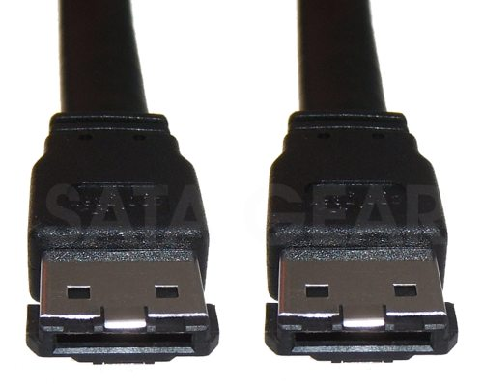
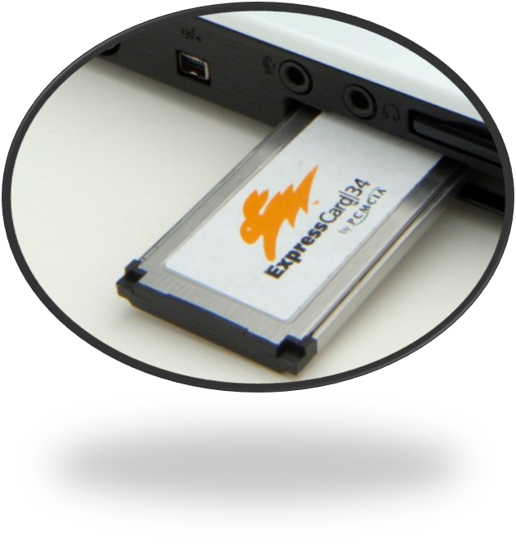
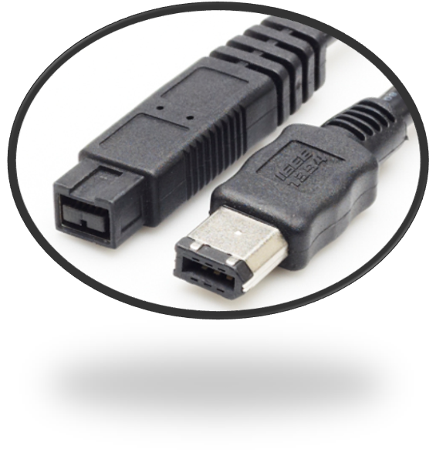
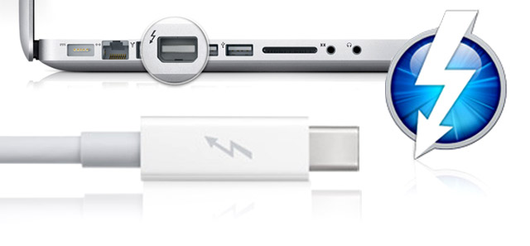
Other available ports and connectors
eSATA
Express Card
Thunderbolt
FireWire

